Slide 1


Open up your science
Mario Malički, Gerben ter Riet

Slide 2
Our Background
Mario Malički
Gerben ter Riet
Croatia
MD, PhD
Medical Ethics
Research Integrity
the Netherlands
MD, PhD
Epidemiology
Research Integrity
Project: Possible uses of automation technology for optimizing funder workflow

Slide 3
Open Science – umbrella term
Open Science
Open Methods
Open Data
Open Peer Review
Open Access
Open Education
Open Metrics and Policies

Slide 4
Development of Open Science
For the history of open science – look at David 2007
For an introduction to open science – look at Cruwell et al 2018
Re-emphasis:
2015 Transparency and Openness Promotion (TOP) guidelines
2016 FAIR Data - Findable, Accessible, Interoperable and Re-usable
2016 EU Open Science Agenda
2018 Plan S/cOAlition S
Paul A. David - THE HISTORICAL ORIGINS OF ‘OPEN SCIENCE’ – Link
Cruwell et al. - 8 Easy Steps to Open Science: An Annotated Reading List - Link

Slide 5
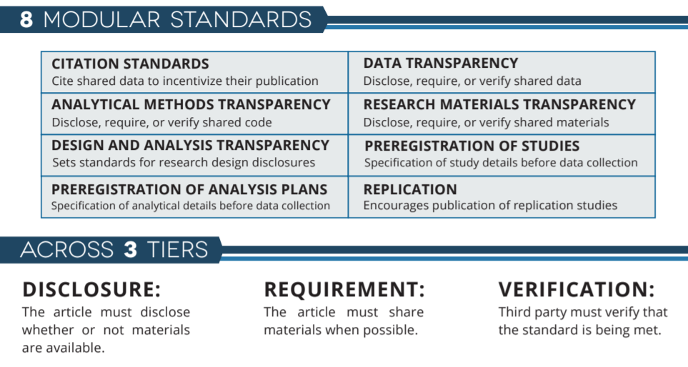
TOP Guidelines – 2015 COS
https://cos.io/our-services/top-guidelines/

Slide 6
A way towards Open Science
1
Preregister your study (including data analysis plan)
2
Collect Data / Conduct the Study
3
Write up your study (using reporting guidelines if available)
4
2,4,5
5
Deposit your non-reviewed manuscript
Deposit your data
Publish your study in peer reviewed outlets

Slide 7
Study preregistration
Topic Registries
Clinicaltrials.gov or The WHO Registry Network for clinical trials
PRECLINICALTRIALS.EU – for animal studies
PROSPERO – health sys. reviews
General registries
Open Science Framework
Mendelay Data
AEA Registry and RIDIE registry for social sciences/economics
AsPredicted

Slide 8

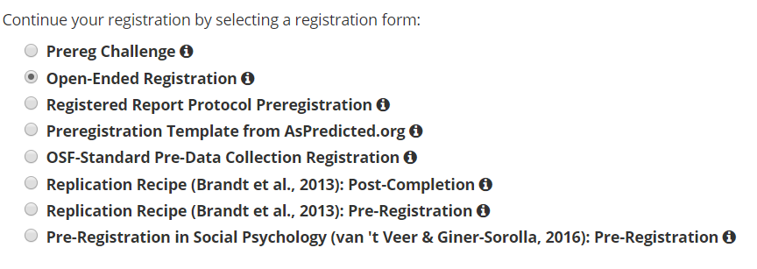

Slide 9
What are reporting guidelines?
statements that provide advice on how to report research methods and findings
usually in the form of a checklist, flow diagram or explicit text
specify a minimum set of items required for a clear and transparent account of a research study, reflecting in particular issues that might introduce bias into the research

Slide 10
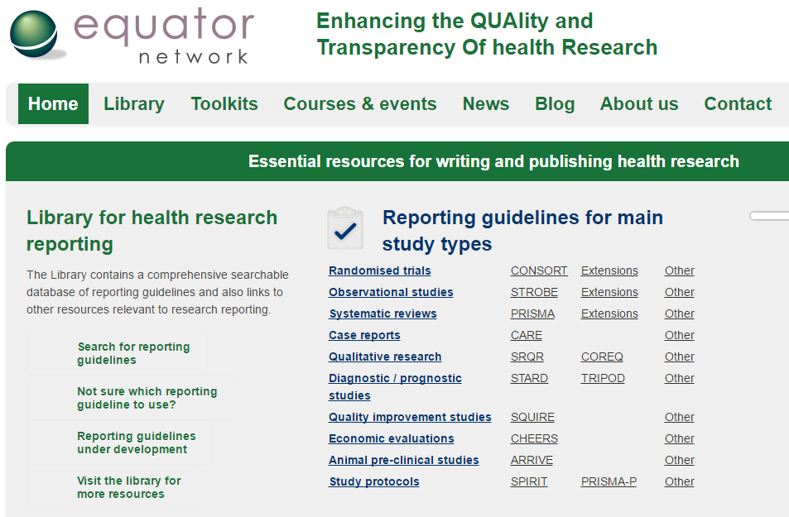

Slide 11
Data Sharing
The journal is committed to open data by encouraging authors to appropriately share the data underpinning their analyses. In a section entitled “Data Availability Statement”, placed directly below the Conclusions section, please provide a statement on the availability of the dataset, software code and/or model underpinning your research. The journal encourages you to consider providing this information as supplementary material, or depositing in a public repository and providing the link in the paper. If these data are not available this must be stated together with the reason why. Please refer to our data sharing policy in the Instructions for Authors.

Slide 12
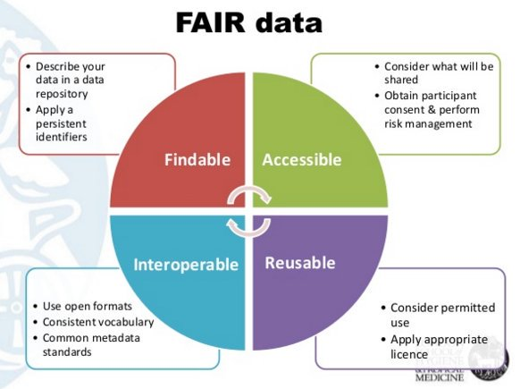
https://www.nature.com/articles/sdata201618
Image by Wilfred Mijnhardt

Slide 13
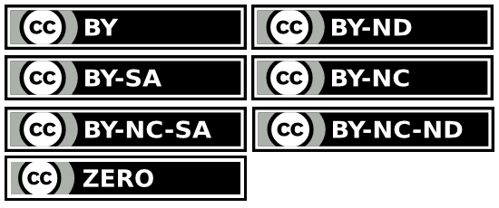
Creative Commons Licenses
Creative commons:
http://creativecommons.org/licenses/
Creative Commons develops, supports, and stewards legal and technical infrastructure that maximizes digital creativity, sharing, and innovation.

Slide 14
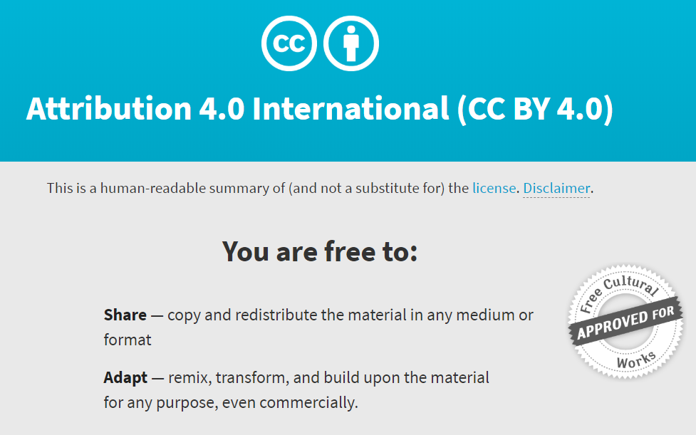
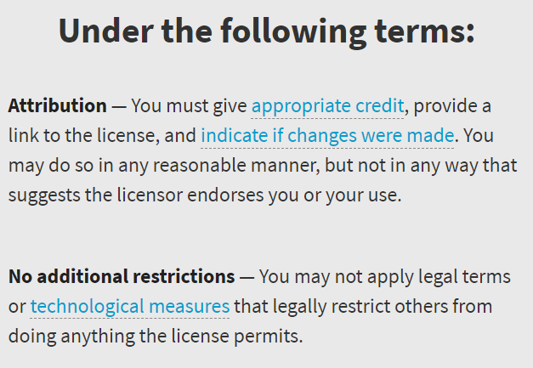

Slide 15
2016 EU Commission – Advisory board on Open Science -European Open Science Agenda – identified 8 priorities
Rewards and Incentives
Research Indicators and Next-Generation Metrics
Future of Scholarly Communication
European Open Science Cloud
FAIR Data
Research Integrity
Skills and Education
Citizen Science
https://ec.europa.eu/research/openscience/index.cfm

Slide 16
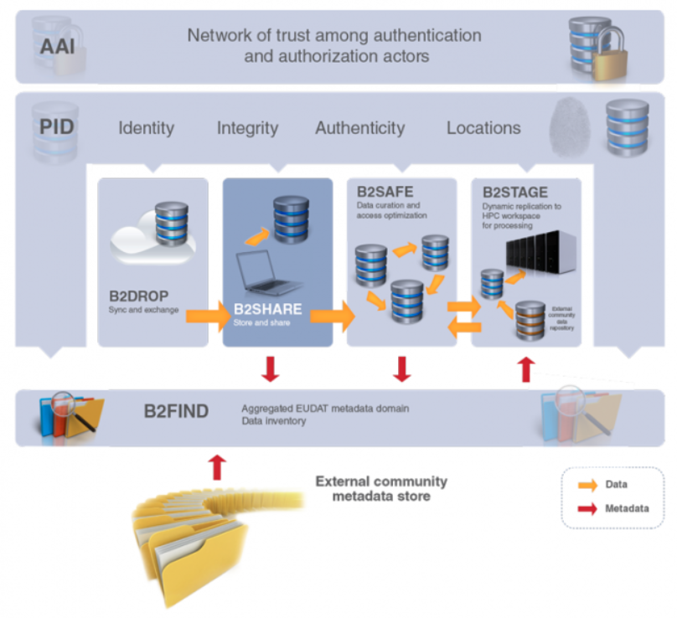
European Open Access cloud – launched 23.11.2018.

Slide 17
Author’s version - preprint
Manuscript
Peer Review
Publication
Traditional Journal Publishing
50+:
ArXiv - 1991
AgriXiv
Arabixiv
bioRxiv
CERN document server
ChemRxiv
ChinaXiv
EarthArXiv
OSF preprints
Mandatory
run by journals
Manuscript
Comments/Peer Review
PrePrint version 2, 3…
PrePrint Publishing
Non-Mandatory
volunteers

Slide 18

Plan S / cOAlition S
After 1 January 2020 scientific publications on the results from research funded by public grants provided by national and European research councils and funding bodies, must be published in compliant Open Access Journals or on compliant Open Access Platforms. (13 National funders, including the Netherlands – NWO)

Slide 19



Type of Open Access
Green
Pre-print – Deposit before peer review
Gold
Open access of a peer reviewed journal publication with APC – Article Processing Charge – author/institution/funder pays for open access
Platinum (diamond)
Open access in a peer reviewed journal - no fee – journal most commonly funded by institutions or stakeholders
Mix
          Hybrid OA
          Delayed OA

Slide 20
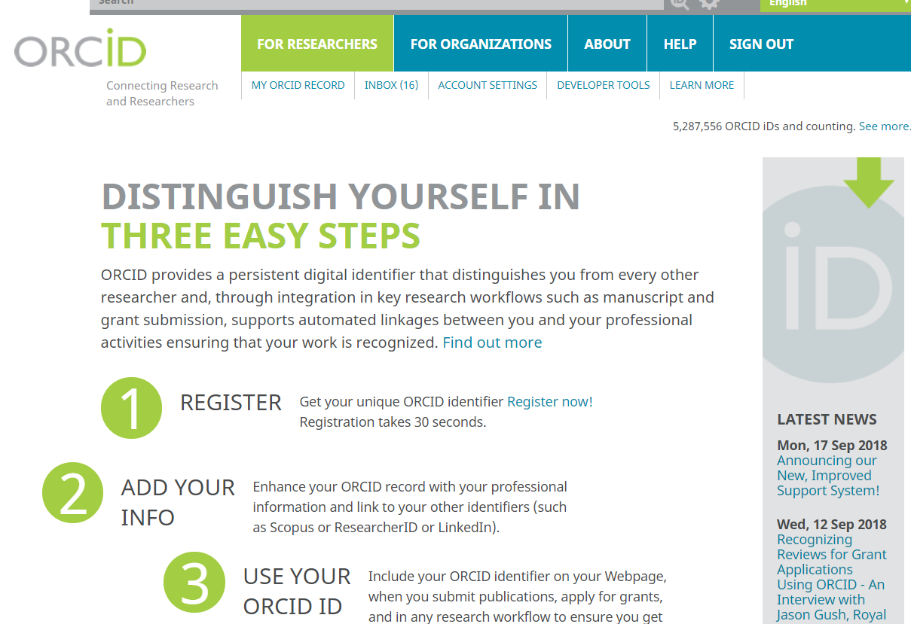

Slide 21
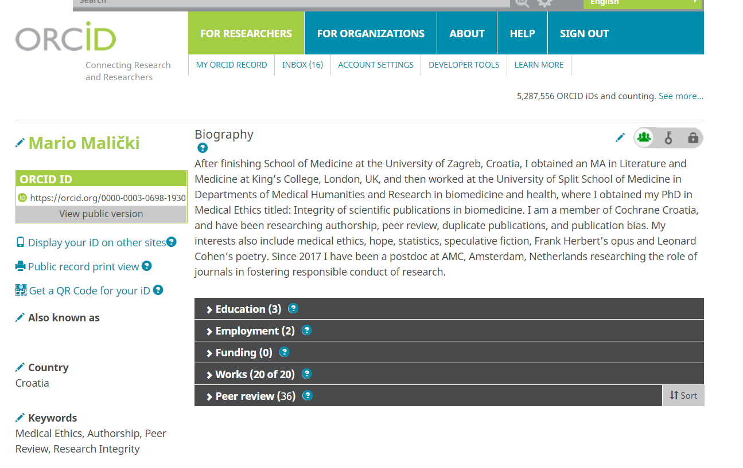

Slide 22


Slide 23
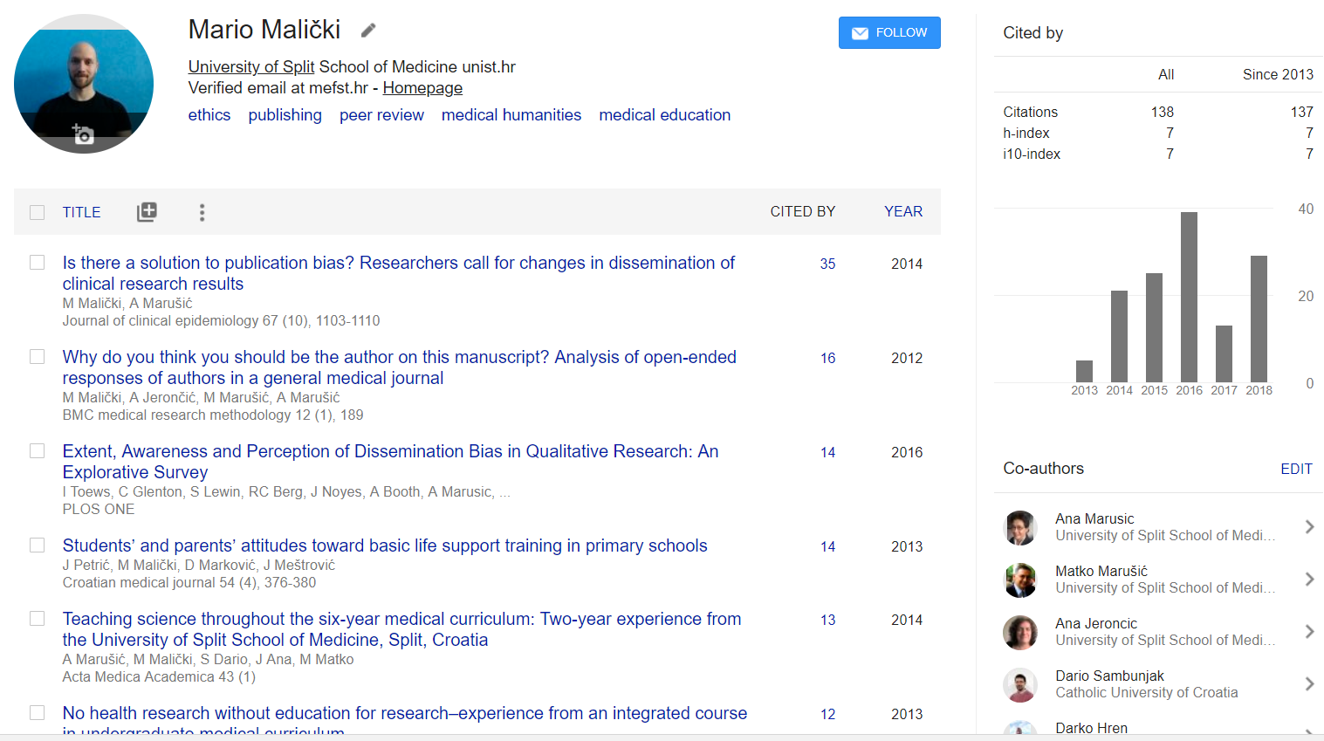

Slide 24
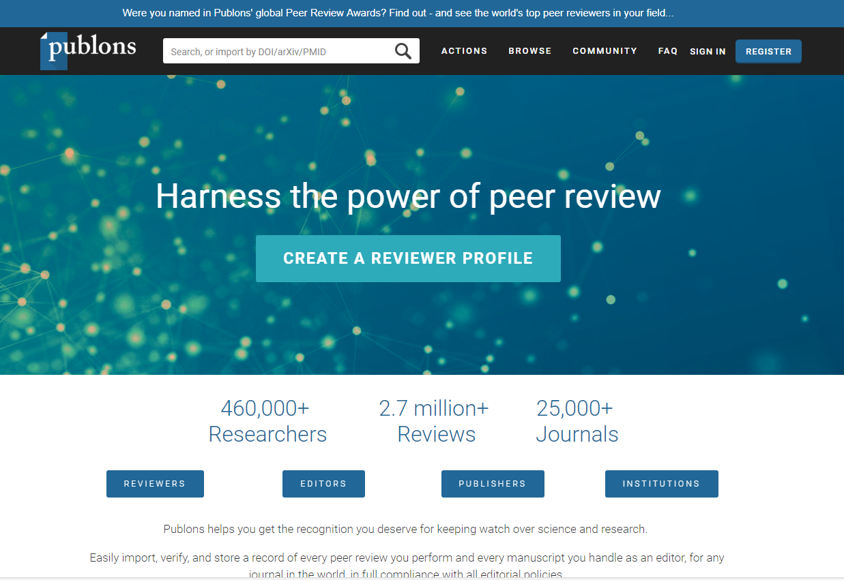

Slide 25
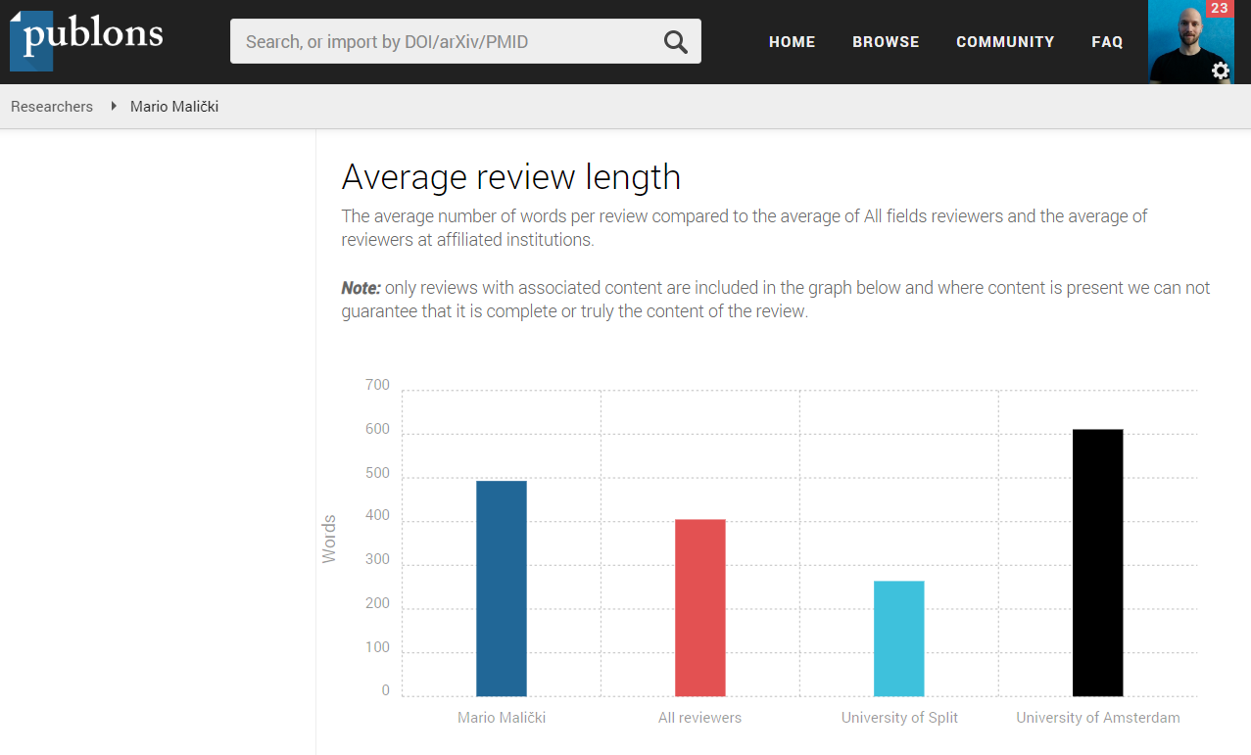

Slide 26
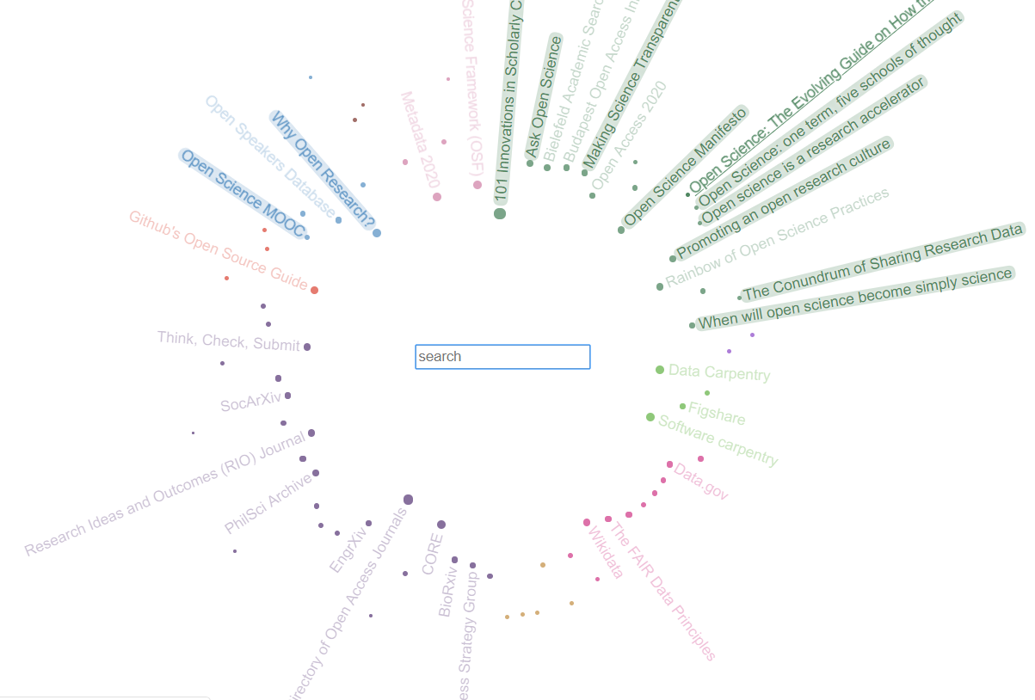
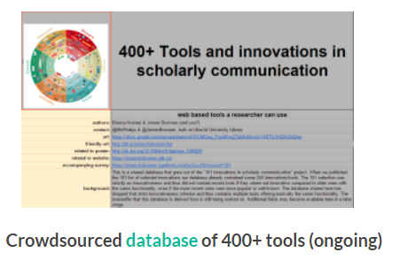
Final two recommendations
http://markhooper.io/openscience/#-1:0000000000
https://101innovations.wordpress.com/outcomes/
Bianca Kramer and Jeroen Bosman Ut Uni Library

Slide 27
Thank you!
Mario Malički: mario.malicki@mefst.hr
Gerben ter Riet: g.terriet@amc.nl

